Slide 1


Slide 2
Feature Engineering

Slide 3
Distance Metrics

Slide 4
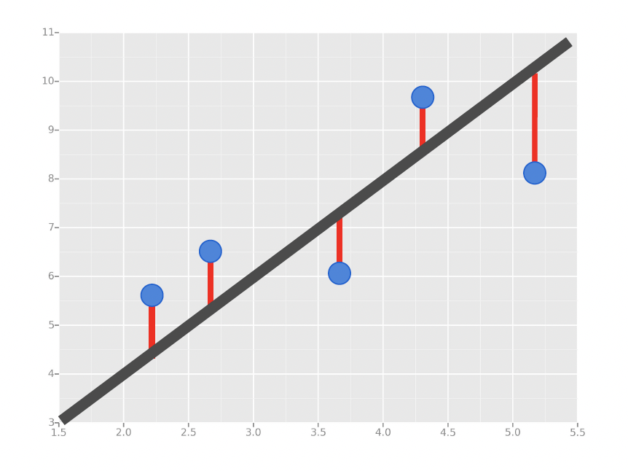
Distance Metrics
In Supervised Learning, we’re concerned with minimizing the distance between our model (e.g. line, curve, etc.) and the gathered data.

Slide 5
Error Metrics
Distance Metrics
In Supervised Learning, we’re concerned with minimizing the distance between our model (e.g. line, curve, etc.) and the gathered data.
For problems with continuous targets (i.e. Regression), there are three common ways we measure distance:
Mean Absolute Error (MAE)
Mean Squared Error (MSE)
Root Mean Squared Error (RMSE)

Slide 6

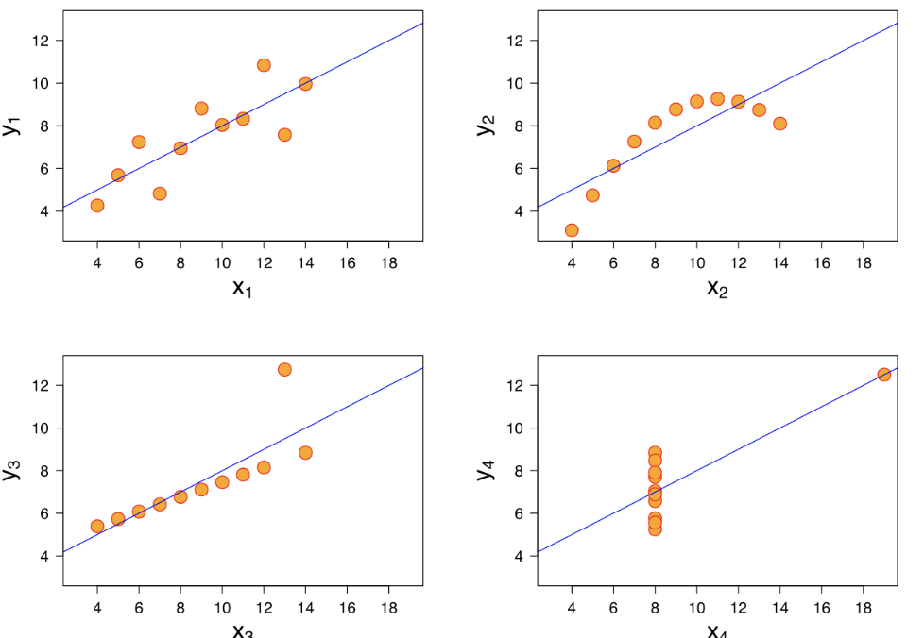
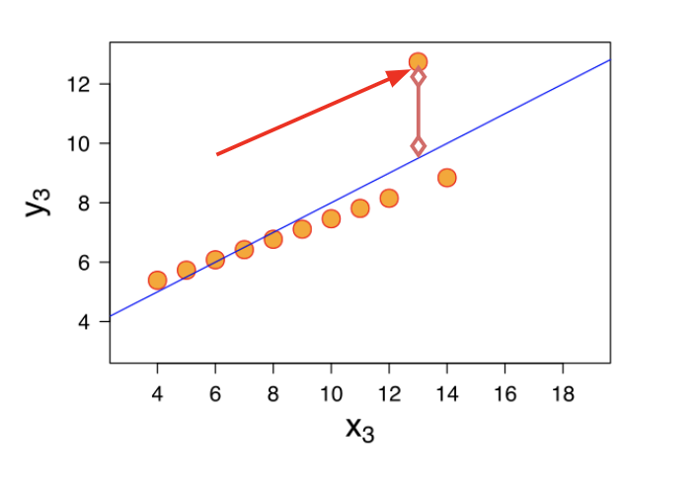
Error Metrics
Distance Metrics
Mean Absolute Error (MAE)
This is the mean of the absolute value of errors.
Easy to understand
MAE won’t punish large errors
We want our error metrics to account for these!
Notes:
Let’s take a moment now to discuss evaluating Regression Models
Regression is a task when a model attempts to predict continuous values (unlike categorical values, which is classification)
You may have heard of some evaluation metrics like accuracy or recall.
These sort of metrics aren’t useful for regression problems, we need metrics designed for continuous values!
Can you give me continuous versus categorical variables?

Slide 7
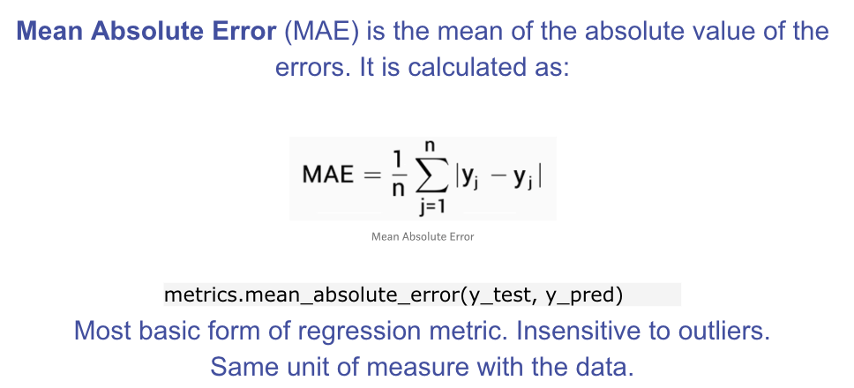
Error Metrics
Distance Metrics

Slide 8
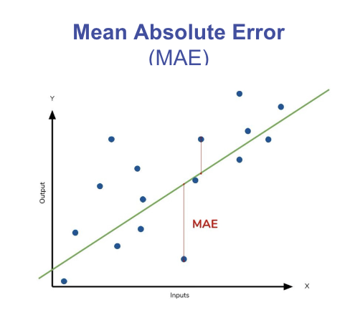
Error Metrics
Distance Metrics

Slide 9
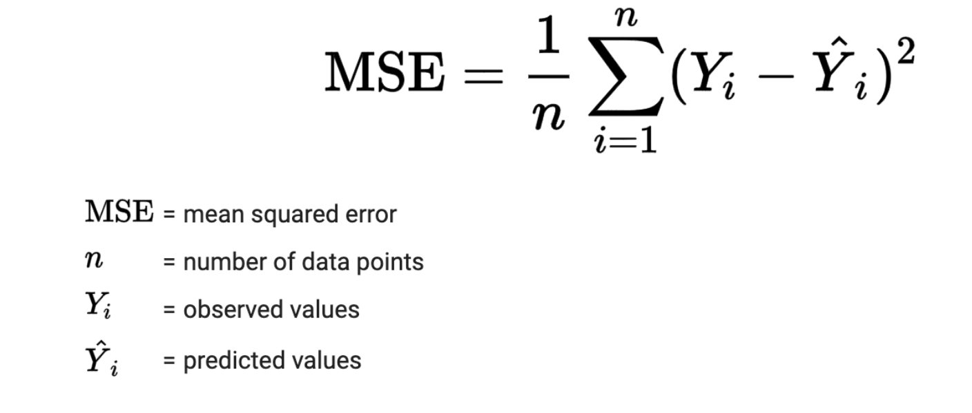
Error Metrics
Distance Metrics
Mean Squared Error (MSE)
This is the mean of the squared errors.
Larger errors are noted more than with MAE, making MSE more popular.
Notes:
Let’s take a moment now to discuss evaluating Regression Models
Regression is a task when a model attempts to predict continuous values (unlike categorical values, which is classification)
You may have heard of some evaluation metrics like accuracy or recall.
These sort of metrics aren’t useful for regression problems, we need metrics designed for continuous values!

Slide 10
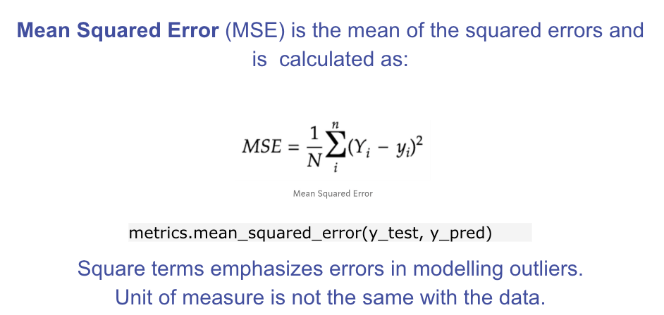
Error Metrics
Distance Metrics
These formulas can be coded up to determine an iterative way to print out the MSE.
Notes:
Let’s analyze what this equation actually means.
In mathematics, the character that looks like weird E is called summation (Greek sigma). It is the sum of a sequence of numbers, from i=1 to n. Let’s imagine this like an array of points, where we go through all the points, from the first (i=1) to the last (i=n).
For each point, we take the y-coordinate of the point, and the y’-coordinate. The y-coordinate is our purple dot. The y’ point sits on the line we created. We subtract the y-coordinate value from the y’-coordinate value, and calculate the square of the result.
The third part is to take the sum of all the (y-y’)² values, and divide it by n, which will give the mean.
Our goal is to minimize this mean, which will provide us with the best line that goes through all the points.

Slide 11
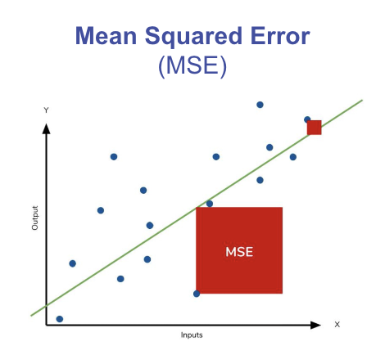
Error Metrics
Distance Metrics

Slide 12

Error Metrics
Distance Metrics
Root Mean Square Error (RMSE)
This is the root of the mean of the squared errors.
Most popular (has same units as y)
Common question: “Is this value of RMSE good?”
Context is everything!
A RMSE of $10 is fantastic for predicting the price of a house, but horrible for predicting the price of a candy bar!
Notes:
Compare your error metric to the average value of the label in your data set to try to get an intuition of its overall performance.
Domain knowledge also plays an important role here!
Context of importance is also necessary to consider.
We may create a model to predict how much medication to give, in which case small fluctuations in RMSE may actually be very significant.
Root Mean Square Error (RMSE) is the standard deviation of the residuals (prediction errors). Residuals are a measure of how far from the regression line data points are; RMSE is a measure of how spread out these residuals are. In other words, it tells you how concentrated the data is around the line of best fit. Root mean square error is commonly used in climatology, forecasting, and regression analysis to verify experimental results.

Slide 13
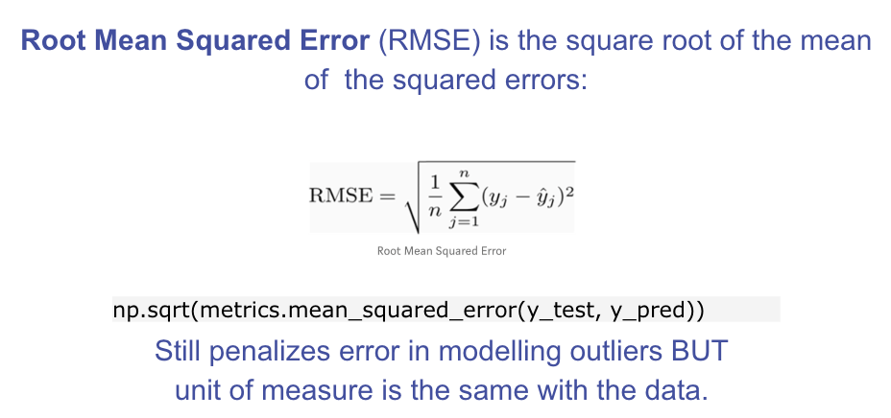
Error Metrics
Distance Metrics

Slide 14
Error Metrics
Distance Metrics
How do we measure “goodness of fit”/”distance” when our outcome is binary (or more broadly, categorical)?

Slide 15
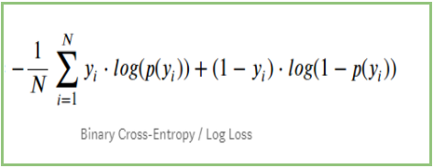
Error Metrics
Distance Metrics
How do we measure “goodness of fit”/”distance” when our outcome is binary (or more broadly, categorical)?
LogLoss (Cross-Entropy):
Used for binary classification problems (0, 1)
Measures the distance between actual values (0, 1) and the probabilities returned by the model (e.g. 0.5, 0.8, 0.9)

Slide 16
Error Metrics
Distance Metrics
LogLoss (Cross-Entropy):
Used for binary classification problems (0, 1)
Measures the distance between actual values (0, 1) and the probabilities returned by the model (e.g. 0.5, 0.8, 0.9)
Baseline Model: Uninformative Model (randomly guessing)

Slide 17
Error Metrics
Distance Metrics
In Supervised Learning, we’re concerned with minimizing the distance between our model (e.g. line, curve, etc.) and the gathered data.

Slide 18
Error Metrics
Distance Metrics
In Supervised Learning, we’re concerned with minimizing the distance between our model (e.g. line, curve, etc.) and the gathered data.
What are some surefire ways in which we can minimize our distance metrics?

Slide 19
Error Metrics
Distance Metrics
In Supervised Learning, we’re concerned with minimizing the distance between our model (e.g. line, curve, etc.) and the gathered data.
What are some surefire ways in which we can minimize our distance metrics?
Better Features
More Features

Slide 20
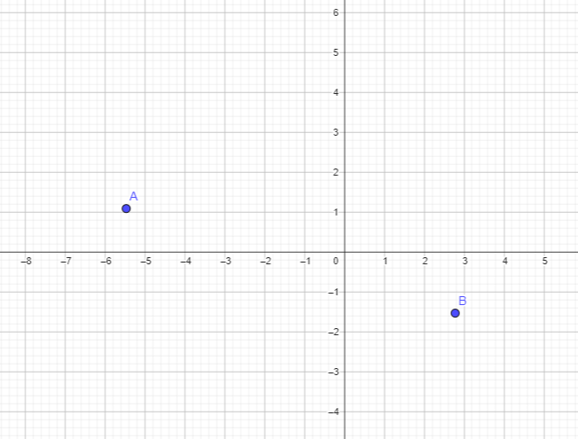
Error Metrics
Distance Metrics
Consider polynomial functions (for easy visualization):
Given 2 data points, what’s the smallest degree polynomial that will perfectly hit both points?

Slide 21
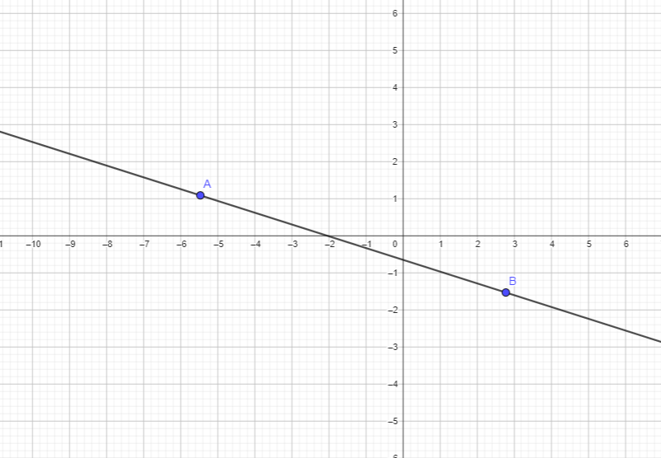
Error Metrics
Distance Metrics
Consider polynomial functions (for easy visualization):
Given 2 data points, what’s the smallest degree polynomial that will perfectly hit both points?
Smallest Degree = 1 (line): mx + b

Slide 22
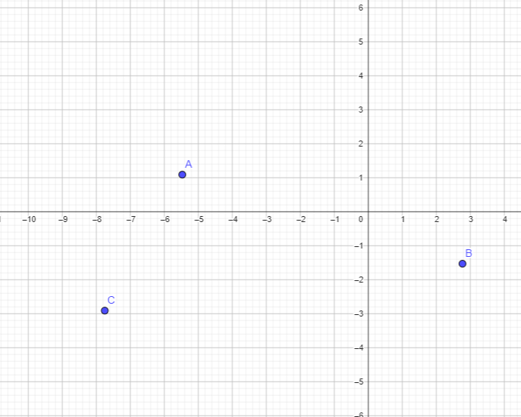
Error Metrics
Distance Metrics
Consider polynomial functions (for easy visualization):
Given 3 data points, what’s the smallest degree polynomial that will perfectly hit both points?

Slide 23
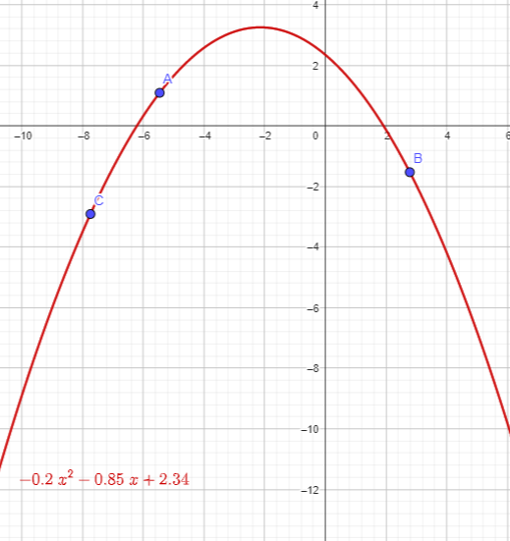

Error Metrics
Distance Metrics
Consider polynomial functions (for easy visualization):
Given 3 data points, what’s the smallest degree polynomial that will perfectly hit both points?
Degree = 2 (Quadratic form):

Slide 24
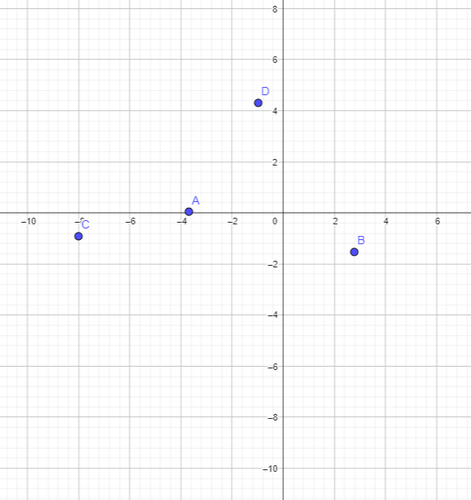
Error Metrics
Distance Metrics
Consider polynomial functions (for easy visualization):
Given 4 data points, what’s the smallest degree polynomial that will perfectly hit both points?

Slide 25
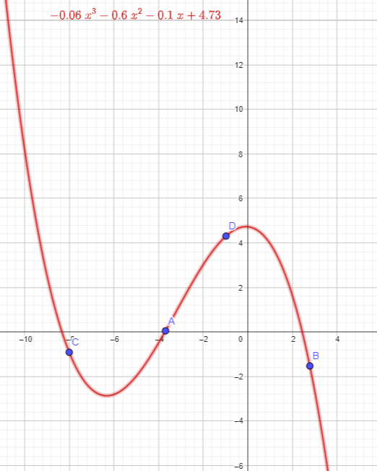
Error Metrics
Distance Metrics
Consider polynomial functions (for easy visualization):
Given 4 data points, what’s the smallest degree polynomial that will perfectly hit both points?
Degree = 3 (cubic form)

Slide 26
Error Metrics
Distance Metrics
In general, if we have n data points, we can find a “line” (or hyperplane) that hits all these points perfectly if we use n-1 variables/dimensions.

Slide 27
Error Metrics
Distance Metrics
In general, if we have n data points, we can find a “line” (or hyperplane) that hits all these points perfectly if we use n-1 variables/dimensions.
Is this something we want?

Slide 28
Error Metrics
Distance Metrics
For continuous cases (regression):
What would be a good baseline model?

Slide 29
Performance Metrics

Slide 30
Performance Metrics
Low enough error metrics, but not too low…
How do we evaluate these?

Slide 31
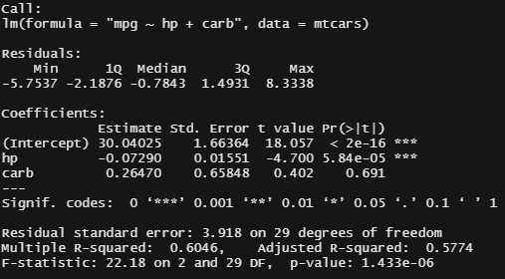
Performance Metrics

Slide 32
Performance Metrics
Residuals: distances between model and data points (y - y_est)
Degrees of freedom (DF): Sample Size - # of Variables (Typically)

Slide 33
Performance Metrics
Residual Standard Error:
Sqrt. of the Sum of Squared Residuals, divided by a denominator based on deg. of freedom s.t. denominator is higher as d.f. increases.

Slide 34
Performance Metrics
R-Squared: % of data’s variability the model is able to account for (~goodness of fit)
Basic/Multiple R-Squared: always approaches 1 as # of variables increases

Slide 35
Performance Metrics
Adjusted R-Square:
Same concept as Multiple R-Squared, but computed such that a penalty is applied for each additional variable included

Slide 36
Testing Metrics

Slide 37
Testing Metrics
Aside from fit metrics that penalize overfitting, we can also make use of methods that split our data into test/train sets (or cross-validations).

Slide 38
Testing Metrics
Aside from fit metrics that penalize overfitting, we can also make use of methods that split our data into test/train sets (or cross-validations).
For Continuous Cases:
We can still make use of RMSE, MAE, MSE to check how well the model is able to generalize.

Slide 39
Testing Metrics
Aside from fit metrics that penalize overfitting, we can also make use of methods that split our data into test/train sets (or cross-validations).
For Continuous Cases:
We can still make use of RMSE, MAE, MSE to check how well the model is able to generalize.
For Classification Cases:
LogLoss is still applicable; however, it’s not as easy to interpret as the distance metrics for continuous case.

Slide 40
Error Metrics
Better Features
In Supervised Learning, we’re concerned with minimizing the distance between our model (e.g. line, curve, etc.) and the gathered data.
What are some surefire ways in which we can minimize our distance metrics?
Better Features
More Features

Slide 41
Feature Engineering

Slide 42
How would you describe a “good” feature?

Slide 43
Feature Engineering
Core Techniques:
One-hot Encoding
Scaling and Standardization
Transformations to remove skew
Aggregating (Features with courser granularity than dataset)
Combining Features (Ratios, Products, Groupings)
Dealing with Outliers
Dealing with Missing Data
Imputation
Alternative Encoding

Slide 44
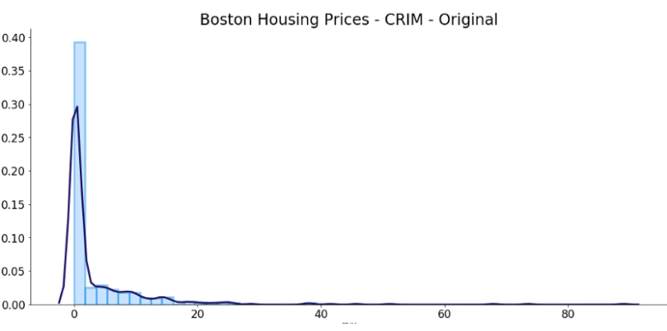
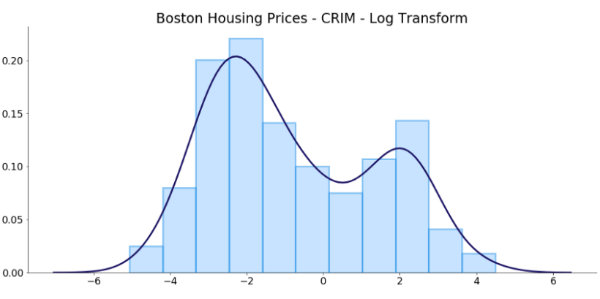

Feature Engineering
Skewed data
How to deal with skewed data?
Log transform
Square root transform
np.log()
np.sqrt()

Slide 45
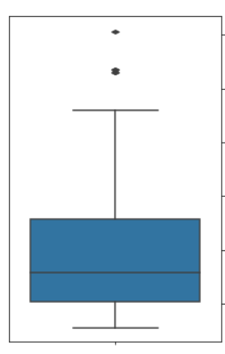
Feature Engineering
Outliers
1 Remove
Value
Variable
2 Remove and study them separately
Studying the outlier might give a different perspective or prompts an opportunity.
3 Assign a new value
Use imputation techniques to replace the value of the outlier.

Slide 46
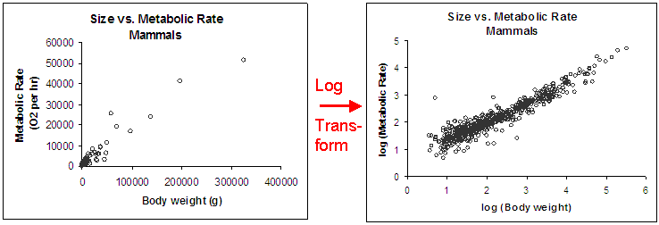
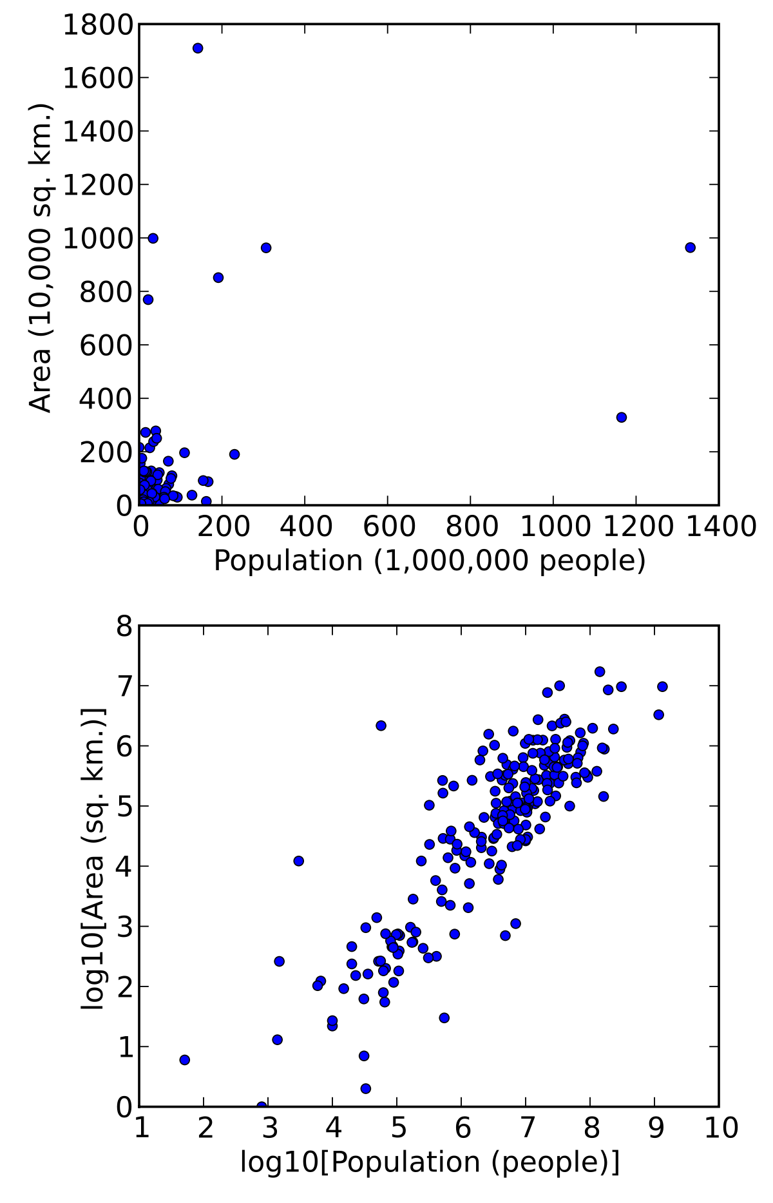
Feature Engineering
Outliers
Transform Log transform
Value
Variable

Slide 47
Data Preparation: Feature Scaling
Feature Engineering
Feature scaling is a method used to standardize the range of independent variables or features of data. In data processing, it is also known as data normalization and is generally performed during the data pre-processing step.
Common Methods:
Standard Scaler
MinMax Scaler
Robust Scaler

Slide 48
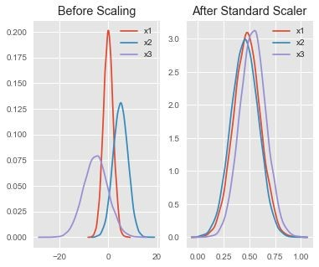
Feature Scaling: Standard Scaler
Feature Engineering
Assumes your data is normally distributed within each feature and will scale them such that the distribution is now centred around 0, with a standard deviation of 1.
The mean and standard deviation are calculated for the feature and then the feature is scaled based on:
x_{i}–mean(x) stdev(x)
If data is not normally distributed, this is not the best scaler to use.

Slide 49
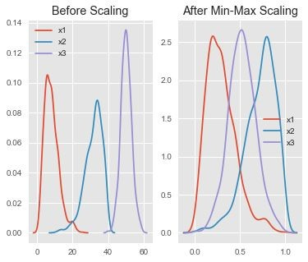
Feature Scaling: Min-Max Scaler
Feature Engineering
One of the most well-known scaling algorithm, and follows the following formula for each feature:
x_{i}–min(x) max(x)–min(x)
It essentially shrinks the range such that the range is now between 0 and 1 (or -1 to 1 if there are negative values).
Works better than Standard Scaler for cases in which the distribution is not Gaussian or the standard deviation is very small
However, it is sensitive to outliers, so if there are outliers in the data, you consider the Robust Scaler.

Slide 50
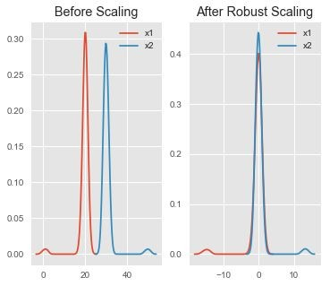
Feature Scaling: Robust Scaler
Feature Engineering
Uses a similar method to the Min-Max scaler but it instead uses the interquartile range, rather than the min-max, so that it is robust to outliers.
Follows the formula:
x_{i}–Q₁(x) Q₃(x)–Q₁(x)
Notice that after Robust scaling, the distributions are brought into the same scale and overlap, but the outliers remain outside of bulk of the new distributions.

Slide 51

Feature Engineering
Mechanisms of Missingness
Missing…
Completely at Random (MCAR)
Reason for missing data is completely unrelated to the analysis being done, or the data that was collected.
At Random (MAR):
Reason for missing data is related to something that was observed or collected.
Not at Random (MNAR)
Reason for missing data is related to something that was not collected (but we would have wanted to collect)

Slide 52
Prepare
Feature Engineering
Mechanisms of Missingness
Missing…
Completely at Random (MCAR)
Cow at the survey forms.
At Random (MAR):
Executives are less likely to state their salary (but they do declare that they are executives).
Not at Random (MNAR)
People who earn more are less likely to state their salary.

Slide 53
Feature Engineering
Mechanisms of Missingness
Missing…
Completely at Random (MCAR)
Generally safe to simply delete these rows.
At Random (MAR):
Generally unsafe to delete, worthwhile to explore imputation.
Not at Random (MNAR)
Generally unsafe to delete, worthwhile to explore imputation.

Slide 54
Testing Metrics
Confusion Matrix Material

Slide 55
Testing Metrics
When you’re doing (binary) classification, one of the steps near the end is setting a threshold s.t. If y_est >= threshold, they’re predicted to be a case (otherwise they’re predicted to be a control.
Are our classification metrics (TPR, FPR, etc) affected by the setting of the threshold?

Slide 56
Testing Metrics
When you’re doing (binary) classification, one of the steps near the end is setting a threshold s.t. If y_est >= threshold, they’re predicted to be a case (otherwise they’re predicted to be a control.
Think of examples where we might want to emphasize one specific metric over another (e.g. Cases where TPR is much more important, even if we have to sacrifice other metrics to raise it).

Slide 57
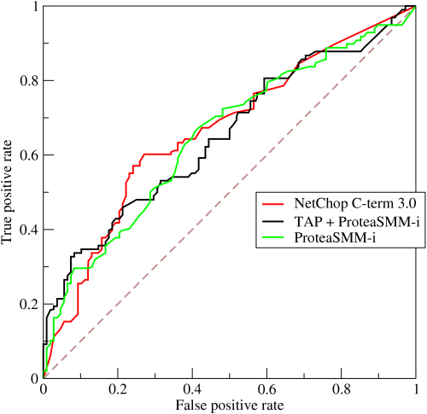
Testing Metrics
The ROC Curve (Receiving Operator Characteristics Curve) plots TPR (sensitivity) and FPR (fallout, 1-specificity) at different threshold values.
The diagonal line is the ROC of the uninformative classifier.

Slide 58
Testing Metrics
AUC: Area under a specific ROC curve.
If AUC <= 0.5, classifier is worse or just as good as uninformative classifier.
Higher AUC -> generally better classifier

Slide 59
Testing Metrics
TPR = TP / P
1 - Specificity = 1 - TN/N

Slide 60
Testing Metrics
TPR = TP / P
1 - Specificity = 1 - TN/N
What happens when the dataset has low prevalence?

Slide 61
Testing Metrics
TPR = TP / P
1 - Specificity = 1 - TN/N
What happens when the dataset has low prevalence?

Slide 62
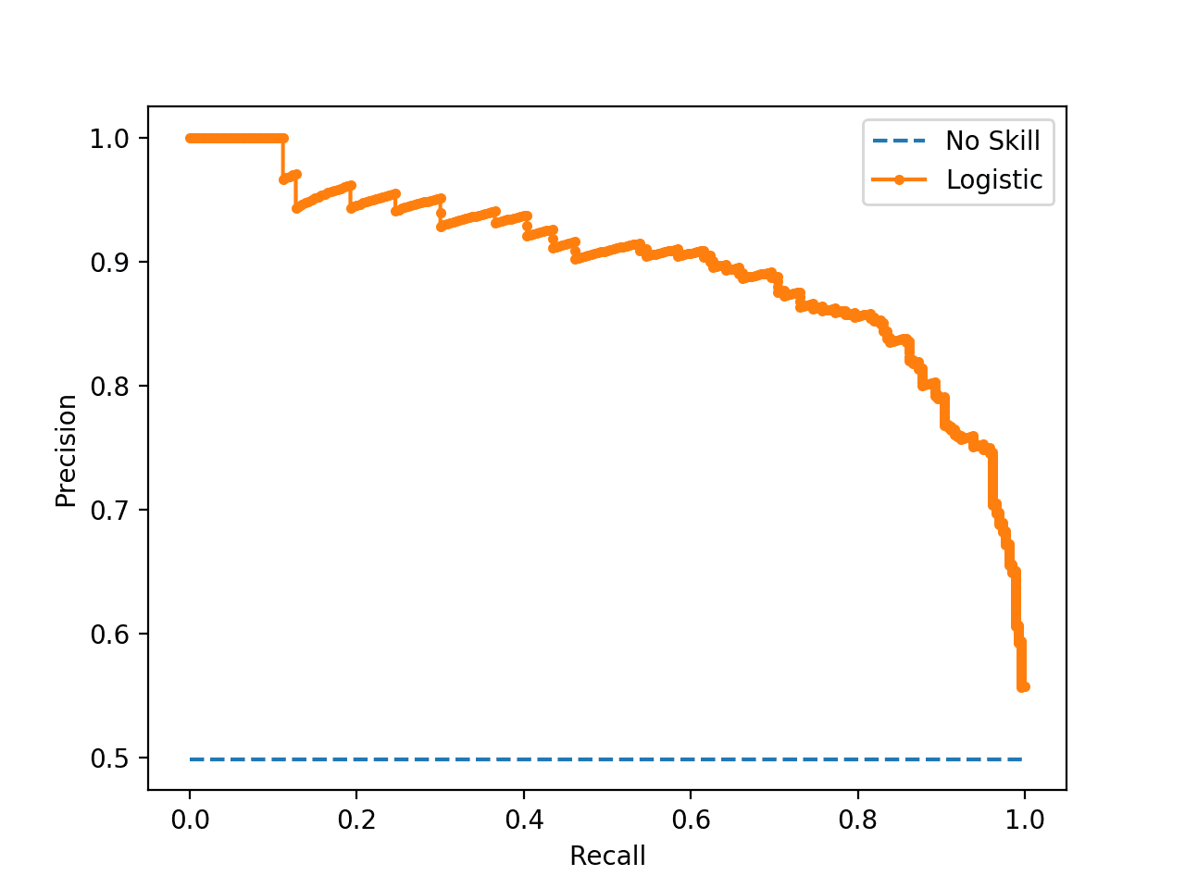
Testing Metrics
If we replace Specificity (which is helped by the over-representation of controls) with Precision (PPV), we can more fairly evaluate our models.

Slide 63
Feature Interpretation

Slide 64
Feature Interpretation
P-Values for Coefficients
P-values for a hypothesis test done on each coefficient, where the null hypothesis is that the coefficient = 0 (no real effect)

Slide 65
Feature Interpretation
Begin by Baselining:
What is the result when all features = 0 (i.e. when only intercept is being read)?

Slide 66
Feature Interpretation
Read the effects ONLY of significant variables (all non-significant variables can be treated as if their coefficients are 0)

Slide 67
Feature Interpretation
How does this work for logistic models?

Slide 68
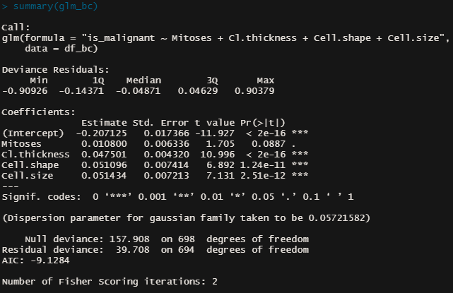
Feature Interpretation
Begin by Baselining:
Given only the intercept (and everything else 0), what’s the probability of being a case?

Slide 69


Feature Interpretation
This is a generalized form of the linear relationship (between feature and target) defined in logistic regression
P is the probability that the sample is a case; the odds ratio indicates how much more likely it is that a sample is case rather than a control

Slide 70
Feature Interpretation
If the odds ratio is 1, what does this mean?
If the odds ratio is less than 1?
If the odds ratio is greater than 1?
P is the probability that the sample is a case; the odds ratio indicates how much more likely it is that a sample is case rather than a control

Slide 71
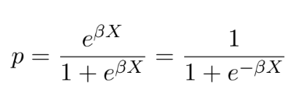
Feature Interpretation
Solving for p gives us:
This expression is just whatever is the result of the linear expression (pre-logistic link function)

Slide 72
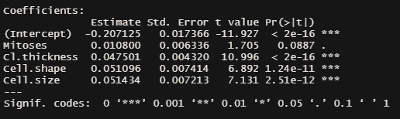
Feature Interpretation
Solving for p gives us:
This expression is just whatever is the result of the linear expression (pre-logistic link function)

Slide 73
Feature Interpretation
Solving for p gives us:
Set all other variables to 0, then the expression will just be the intercept: -0.20
Plugging this in gives us:
p_intercept ~ 0.45
(Consider what this looks like if the intercept is 0)

Slide 74
Feature Interpretation
Solving for p gives us:
Take a look at the expression above.
What happens when the BX portion increases? What happens when it decreases?

Slide 75
Interpreting Clusters

Slide 76
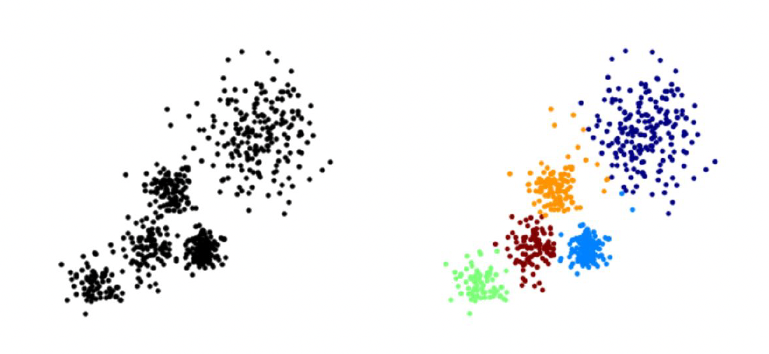
Interpreting Clusters
The overall goal is to divide data into distinct groups such that observations within each group are similar
Here you can see a diagram of unlabelled training data and k means clustering trying to attempt to cluster that data into five distinct clock colored clusters.

Slide 77
Interpreting Clusters
So far, a lot of the interpretation we’ve done has been against some “truth” that we were trying to model (i.e. labels). How about unsupervised algorithms?

Slide 78
Interpreting Clusters
So far, a lot of the interpretation we’ve done has been against some “truth” that we were trying to model (i.e. labels). How about unsupervised algorithms?
“fitting metrics”: distance of centroids, density, elbow-method
Practical Usage

Slide 79
Interpreting Clusters
So far, a lot of the interpretation we’ve done has been against some “truth” that we were trying to model (i.e. labels). How about unsupervised algorithms?
“fitting metrics”: distance of centroids, density, elbow-method
Practical Usage -
Interpretability and actual distinction of clusters (when being described)
Number of clusters (for your use case, is 10 segments practical? Is 20? Is 5?)

Slide 80
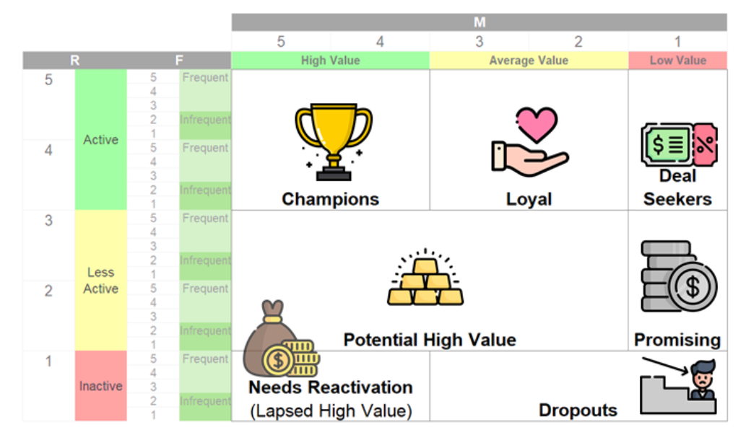
Interpreting Clusters
Other Type of Customer Segmentation RFM
Clustering done via rules/thresholds rather than multidimensional computations are sometimes more practical
(and immediately interpretable)

